Slide 1
네트워크
프로그래밍
08. ICMP
CONTENTS
Lab 08 : ICMP
휴먼지능정보공학과 201810800
이혜인

Slide 2
Lab 08 : ICMP
Questions with Ping activities
  Examine one of the ping request packets sent by your host. What are the ICMP type and code numbers? What other fields does this ICMP packet have?
  Examine the corresponding ping reply packet. What are the ICMP type and code numbers? What other fields does this ICMP packet have?
Questions with Traceroute activities
  Examine the ICMP echo packet in your screenshot. Is this different from the ICMP ping query packets in the first half of this lab? If yes, how so?
  Examine the ICMP error packet in your screenshot. It has more fields than the ICMP echo packet. What is included in those fields?
  Examine the last three ICMP packets received by the source host. How are these packets different from the ICMP error packets? Why are they different?
  강의노트에서 배운 내용과 다른 점을 찾아라.
Index

Slide 3
ICMP
Lab 08 : ICMP
Questions with Ping activities

Slide 4
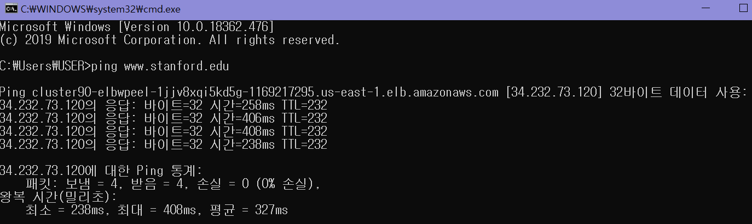
Lab 08 : ICMP
Questions with Ping activities
Examine one of the ping request packets sent by your host. What are the ICMP type and code numbers? What other fields does this ICMP packet have?
ICMP
Cmd창에 “ping www.Stanford.edu”를 작성하고 Wireshark를 통해
캡처를 시작한다.

Slide 5
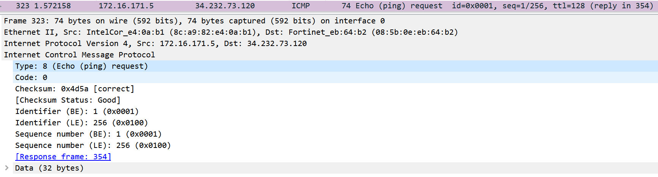
Lab 08 : ICMP
Questions with Ping activities
Examine one of the ping request packets sent by your host. What are the ICMP type and code numbers? What other fields does this ICMP packet have?
ICMP
Host에서 보낸 ping request 패킷 중 하나를 확인했을 때, ICMP Type은 8
(Echo (ping)) request이고, Code는 0이다. 이때, ICMP Type 8(Echo)에는
Code가 존재하지 않기때문에 Code는 0이라고 표시된 것이다.

Slide 6
Lab 08 : ICMP
Questions with Ping activities
Examine one of the ping request packets sent by your host. What are the ICMP type and code numbers? What other fields does this ICMP packet have?
ICMP
ICMP Packet에 존재하는 fields는 ICMP Type과 Code이외에도 Checksum, Identifier, Sequence number가 존재한다.

Slide 7
Lab 08 : ICMP
Questions with Ping activities
Examine one of the ping request packets sent by your host. What are the ICMP type and code numbers? What other fields does this ICMP packet have?
ICMP
Checksum : 0x4d5a [correct]
[Checksum status: Good]
Identifier (BE) : 1 (0x0001)
Identifier (LE) : 256 (0x0100)
Sequence number (BE) : 1 (0x0001)
Sequence number (LE) : 256 (0x0100)
[Response frame: 354]

Slide 8
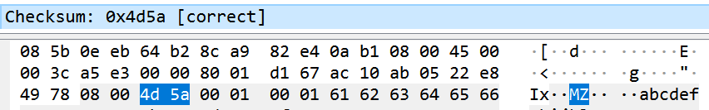
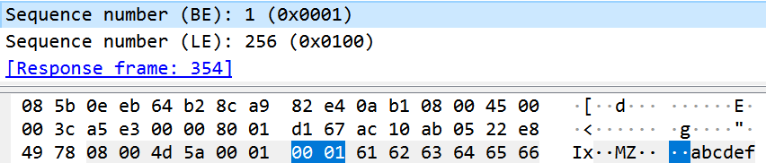
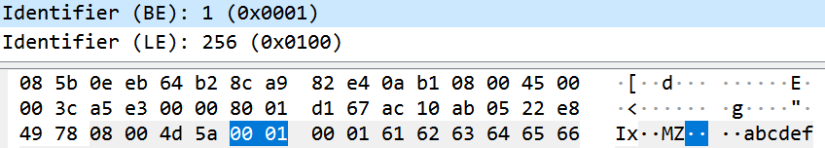


Lab 08 : ICMP
Questions with Ping activities
Examine one of the ping request packets sent by your host. What are the ICMP type and code numbers? What other fields does this ICMP packet have?
ICMP
Checksum – 2byte
Identifier (BE) + Identifier (LE) – 2byte
Sequence number (BE) + Sequence number (LE) – 2byte

Slide 9
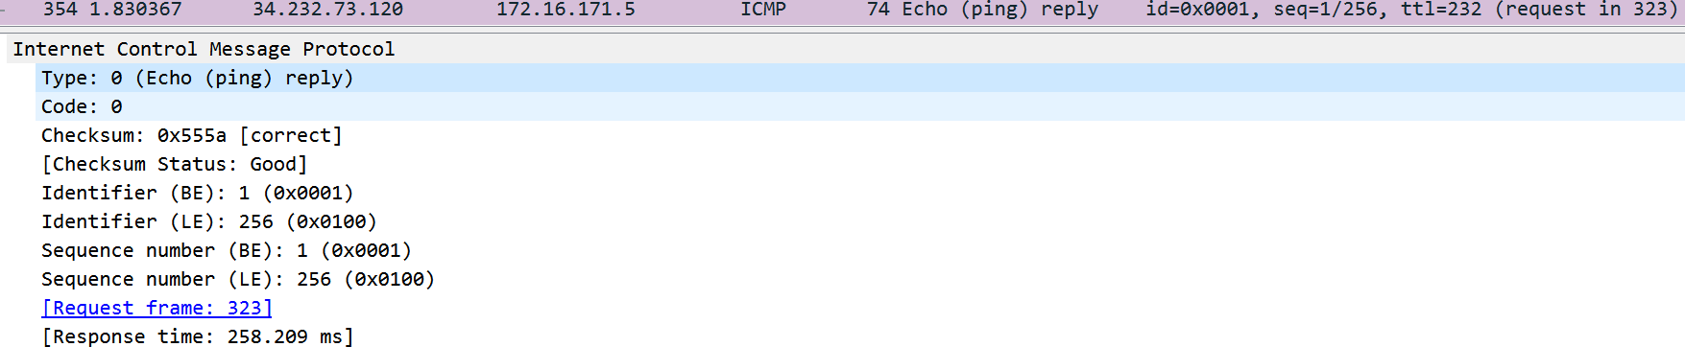
Lab 08 : ICMP
Questions with Ping activities
Examine the corresponding ping reply packet. What are the ICMP type and code numbers? What other fields does this ICMP packet have?
ICMP
Host에서 보낸 ping reply 패킷 중 하나를 확인했을 때, ICMP Type은 0
(Echo (ping)) reply이고, Code는 0이다. 이때, ICMP Type 0(Echo reply)에는
Code가 존재하지 않기때문에 Code는 0이라고 표시된 것이다.

Slide 10
Lab 08 : ICMP
Questions with Ping activities
Examine the corresponding ping reply packet. What are the ICMP type and code numbers? What other fields does this ICMP packet have?
ICMP
ICMP Packet에 존재하는 fields는 ICMP Type과 Code이외에도 Checksum, Identifier, Sequence number가 존재한다.

Slide 11
Lab 08 : ICMP
Questions with Ping activities
Examine the corresponding ping reply packet. What are the ICMP type and code numbers? What other fields does this ICMP packet have?
ICMP
Checksum : 0x555a [correct]
[Checksum status: Good]
Identifier (BE) : 1 (0x0001)
Identifier (LE) : 256 (0x0100)
Sequence number (BE) : 1 (0x0001)
Sequence number (LE) : 256 (0x0100)
[Request frame: 323]
[Response time: 258.209 ms]

Slide 12
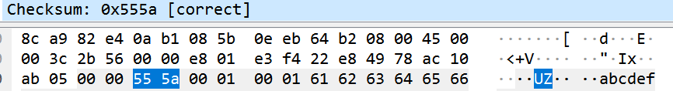
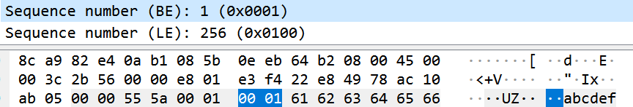
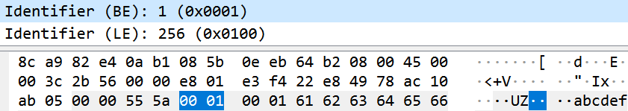
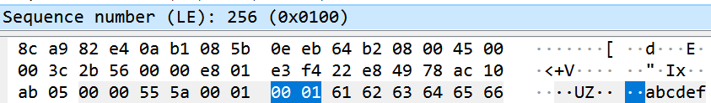

Lab 08 : ICMP
Questions with Ping activities
Examine the corresponding ping reply packet. What are the ICMP type and code numbers? What other fields does this ICMP packet have?
ICMP
Checksum – 2byte
Identifier (BE) + Identifier (LE) – 2byte
Sequence number (BE) + Sequence number (LE) – 2byte

Slide 13
ICMP
Lab 08 : ICMP
Questions with Traceroute activities

Slide 14
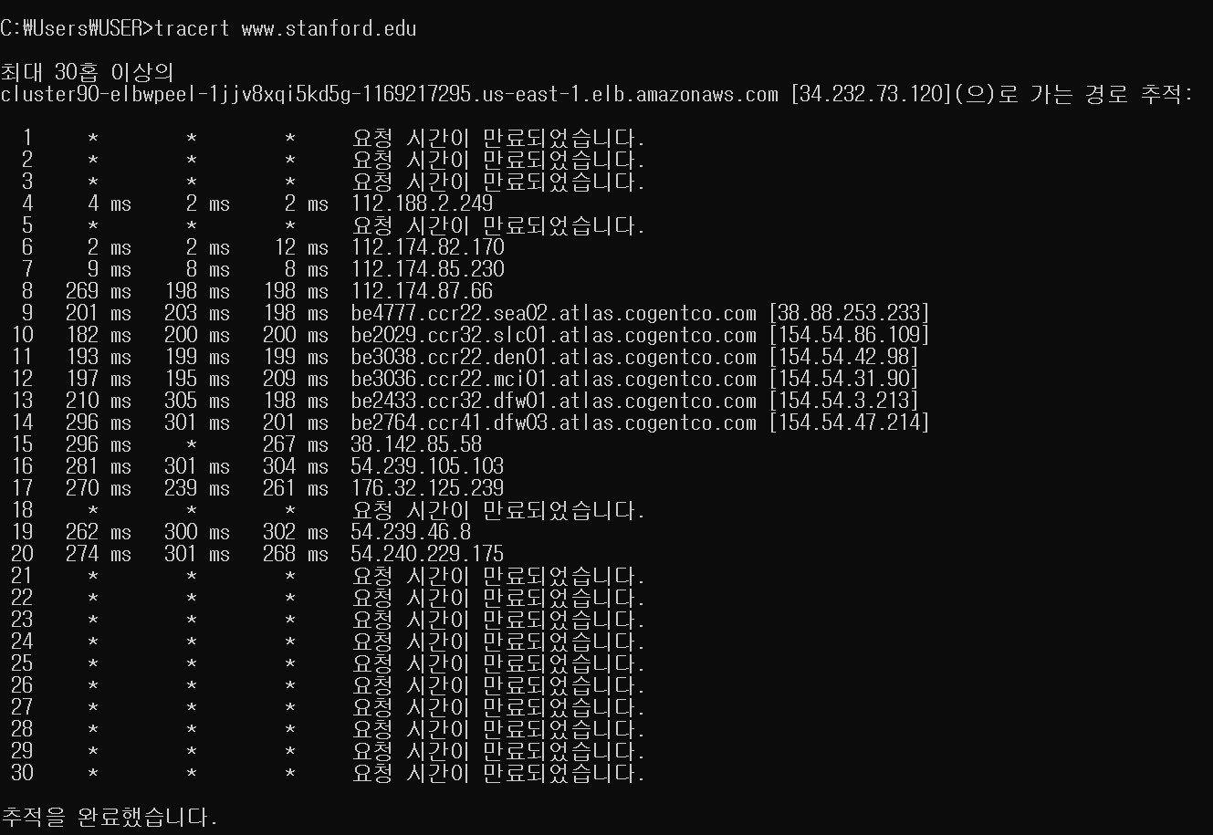
Lab 08 : ICMP
Questions with Traceroute activities
Examine the ICMP echo packet in your screenshot. Is this different from the ICMP ping query packets in the first half of this lab? If yes, how so?
ICMP
Cmd창에 “tracert www.Stanford.edu”를 작성하고 Wireshark를 통해
캡처를 시작한다.

Slide 15
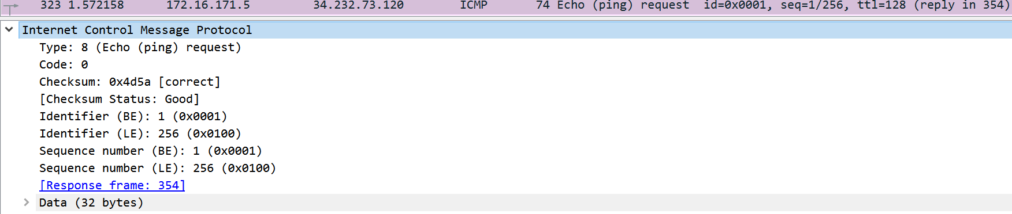
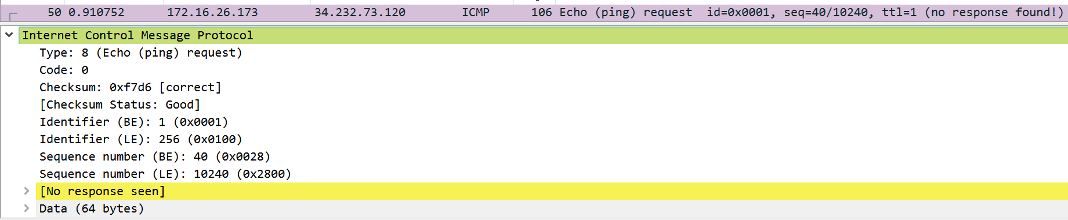
Lab 08 : ICMP
Questions with Traceroute activities
Examine the ICMP echo packet in your screenshot. Is this different from the ICMP ping query packets in the first half of this lab? If yes, how so?
ICMP
ICMP ping query packet
ICMP echo query packet

Slide 16
Lab 08 : ICMP
Questions with Traceroute activities
Examine the ICMP echo packet in your screenshot. Is this different from the ICMP ping query packets in the first half of this lab? If yes, how so?
ICMP
ICMP echo packet은 앞에 있는 ICMP ping query packets과 동일한 fields를 가지고 있다.
다만 ICMP echo packet은 response가 없어서 [No response seen]이라고 나와있다.

Slide 17
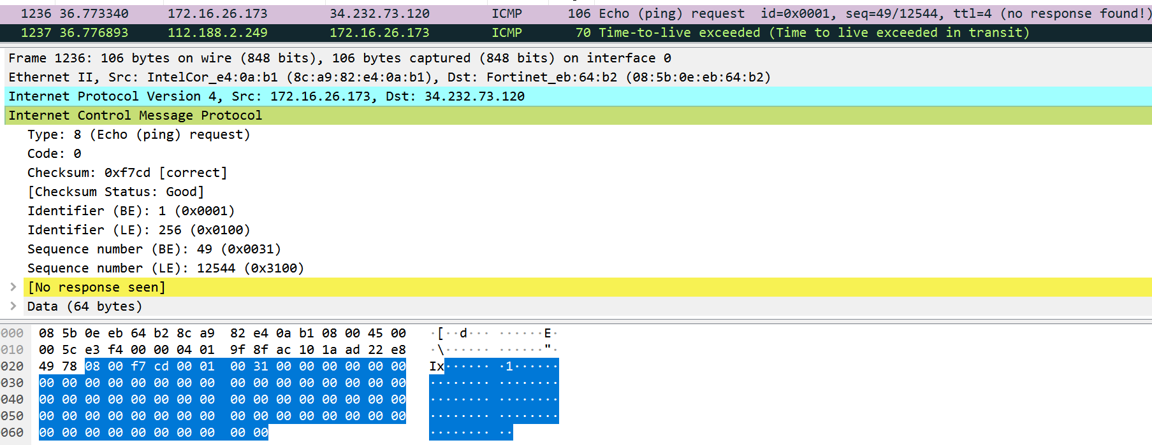
Lab 08 : ICMP
Questions with Traceroute activities
Examine the ICMP error packet in your screenshot. It has more fields than the ICMP echo packet. What is included in those fields?
ICMP
ICMP echo query packet

Slide 18
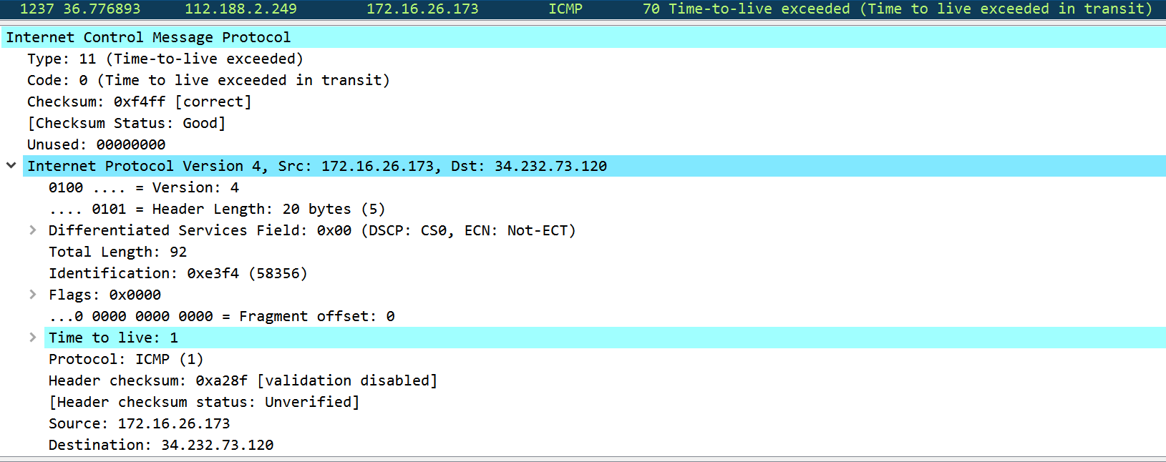
Lab 08 : ICMP
Questions with Traceroute activities
Examine the ICMP error packet in your screenshot. It has more fields than the ICMP echo packet. What is included in those fields?
ICMP
ICMP error packet

Slide 19
Lab 08 : ICMP
Questions with Traceroute activities
Examine the ICMP error packet in your screenshot. It has more fields than the ICMP echo packet. What is included in those fields?
ICMP
ICMP error packet은 ICMP echo packet와 다른 Type과 checksum, 그리고 IPv4를 가지고 있다. 즉, IP Header와 오류가 있는 원래 ICMP 패킷의 처음 8byte를 모두 포함한다.
내용
Type: 11 (Time-to-live exceeded)
Code: 0 (Time to live exceeded in transit)
Checksum: 0xf4ff [correct]
[Checksum Status: Good]
Unused: 00000000
…
Time to live: 1

Slide 20
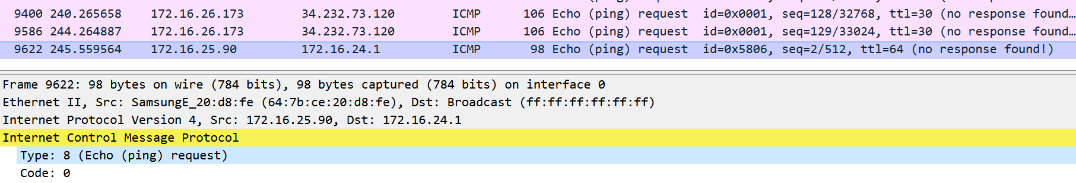
Lab 08 : ICMP
Questions with Traceroute activities
Examine the last three ICMP packets received by the source host. How are these packets different from the ICMP error packets? Why are they different?
ICMP
원래 기대하는 마지막 3개의 패킷은 reply packet으로 Type 0이 나와 Net Unreachable임을 보여줘야 했지만, 해당 그림에서는 이를 확인할 수 없다.
즉, 마지막 3개의 패킷이 기존에 있는 패킷과 다른 게 없다.
이 이유는 사설 IP에서 요청하면 대답을 해주지 않기 때문이다.

Slide 21
Lab 08 : ICMP
Questions with Traceroute activities
강의노트에서 배운 내용과 다른 점을 찾아라.
ICMP
→ 강의노트 내용
source sends series of UDP segments to dest
  first set has TTL =1
  second set has TTL=2, etc.
  unlikely port number
when n^{th} set of packets arrives to n^{th} router:
  router discards packets
  and sends source ICMP messages (type 11, code 0: “TTL Expired”)
  ICMP messages includes name of router & IP address
when ICMP messages arrives, source records RTTs
stopping criteria:
  UDP segment eventually arrives at destination host
  destination returns ICMP “port unreachable” message (type 3, code 3)
  source stops
Recent Windows’ “TraceRT” command uses Ping Echo requests with small TTLs. Destination returns Ping Echo-reply.

Slide 22
Lab 08 : ICMP
Questions with Traceroute activities
강의노트에서 배운 내용과 다른 점을 찾아라.
ICMP
강의 노트에서는 UDP가 destination host에 도착하고, 라우터에 도착하면 TTL을 1씩 줄이는 방식과 포트 넘버를 이상한 것을 보내 ‘최종적으로는 포트가 없다는 것을 받아야 한다.’라고 배웠다. 즉, Network Unreachable이어야 한다는 것이다.
하지만 내가 관찰한 Packets은 ping을 이용하고 Unreachable이 아닌 TTL 오류를 볼 수 있다. 즉, 최근 윈도우의 “TraceRT” 명령은 작은 TTL이 있는
Ping Echo request를 사용한다. 그리고 목적지는 Ping Echo reply로
돌아온다.

